Slide 1
Power BI Dev Camp Session for PBI50 Developing for Power BI with .NET 5
Ted Pattison
Principal Program Manager
Customer Advisory Team (CAT) at Microsoft

Slide 2
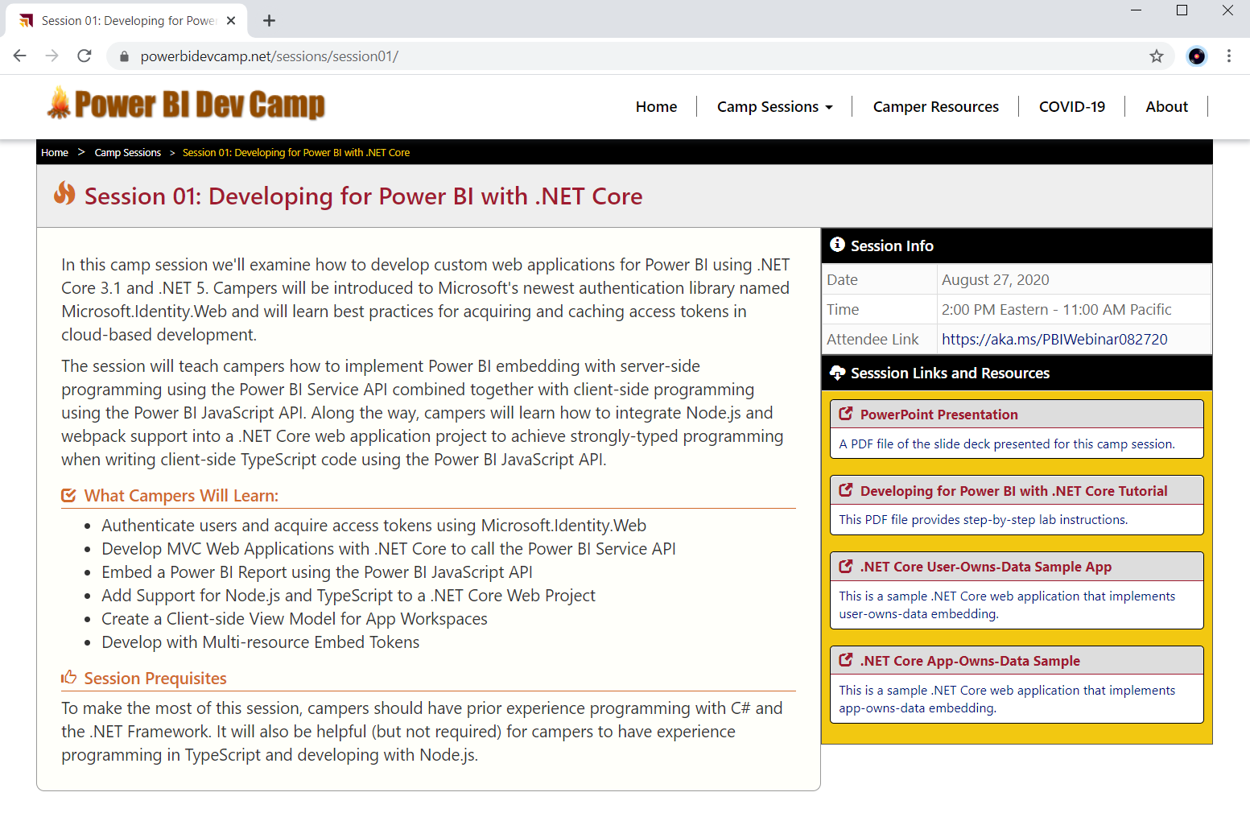
Welcome to Power BI Dev Camp
Power BI Dev Camp Portal - https://powerbidevcamp.net

Slide 3
Agenda
Tutorial Introduction
Developing with .NET 5
Introducing Microsoft.Identity.Web
Calling the Power BI Service API
Programming the Power BI JavaScript API
Adding TypeScript Support to a .NET 5 Project
Programming with Multi-Resource Embed Tokens

Slide 4
Power BI Embedding – The Big Picture
User launches your app using a browser
App authenticates with Azure Active Directory and obtains access token
App uses access token to call to Power BI Service API
App retrieves data for embedded resource and passes it to browser.
Client-side code uses Power BI JavaScript API to create embedded resource
Embedded resource session created between browser and Power BI service
5
Power BI Service
Browser
iFrame
6
4
4
3
1
Your App
2
Azure AD

Slide 5
Choosing the Correct Embedding Model
User-Owns-Data Embedding
All users require a Power BI license
Useful in corporate environments
App authenticates as current user
Your code runs with user’s permissions
User’s access token passed to browser
App-Owns-Data Embedding
No users require Power BI license
Useful in commercial applications
App authenticates with app-only identity
Your code runs with admin permissions
Embed token passed to browser
User-Owns-Data Embedding for use within Organization
App-Owns-Data Embedding for use by ISVs
Browser
Power BI Service
Browser
Power BI Service
iFrame
iFrame
Azure AD
Access Token
Power BI
Embed Token

Slide 6
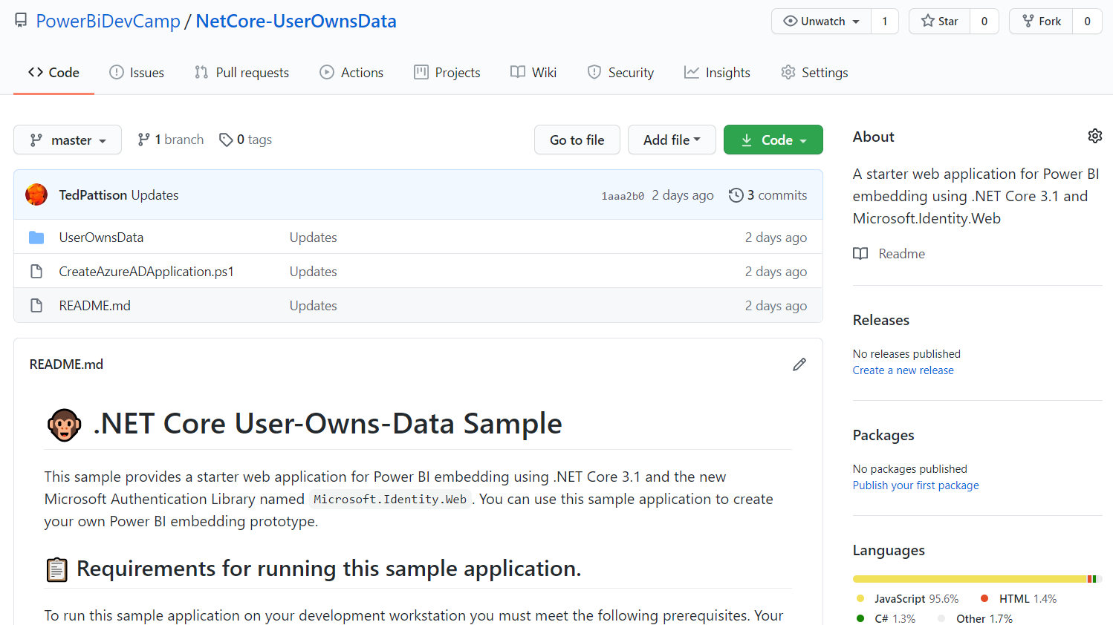
User-Owns-Data Sample Application
Stored in a GitHub repository for easy download
https://github.com/PowerBiDevCamp/NetCore-UserOwnsData

Slide 7
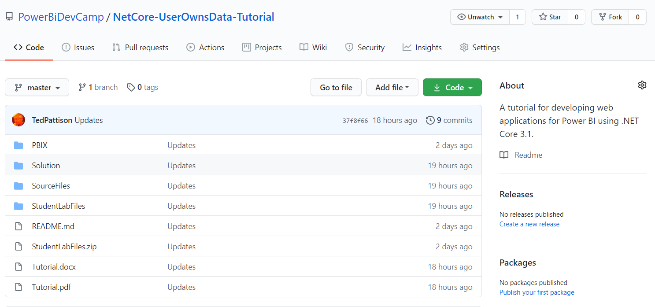
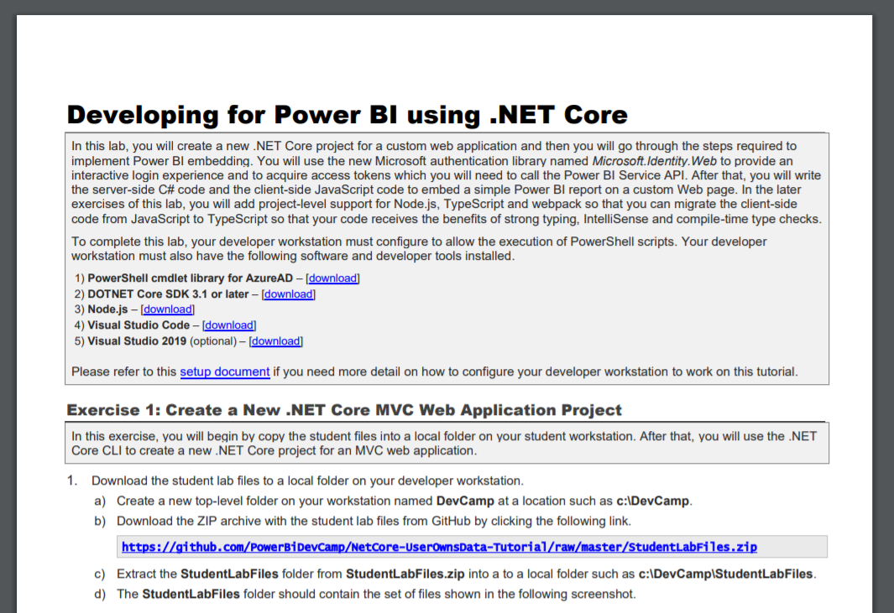
Tutorial: Developing for Power BI using .NET 5
https://github.com/PowerBiDevCamp/NetCore-UserOwnsData-Tutorial

Slide 8
Tutorial Exercise Flow
Exercise 1: Create a New .NET 5 MVC Web Application Project
Exercise 2: Implement User Login using Microsoft.Identity.Web
Exercise 3: Call the Power BI Service API
Exercise 4: Embedding a Report using powerbi.js
Exercise 5: Adding TypeScript Support to a .NET 5 Project
Exercise 6: Creating a View Model for App Workspaces

Slide 9
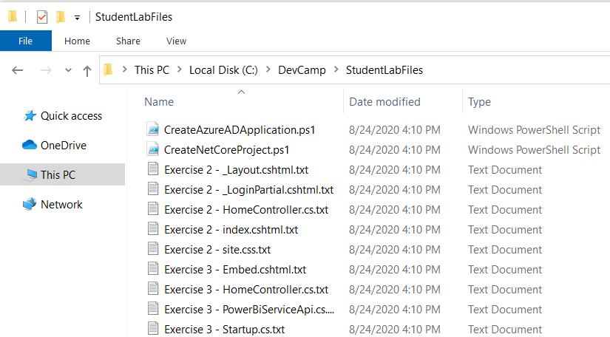
Copying-and-Pasting Code

Slide 10
Agenda
Tutorial Introduction
Developing with .NET 5
Introducing Microsoft.Identity.Web
Calling the Power BI Service API
Programming the Power BI JavaScript API
Adding TypeScript Support to a .NET 5 Project
Programming with Multi-Resource Embed Tokens

Slide 11
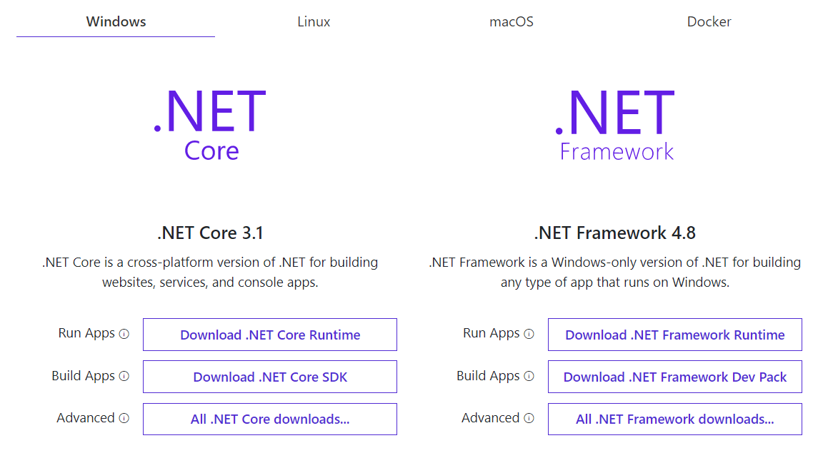
Install .NET 5 SDK
https://dotnet.microsoft.com/download

Slide 12
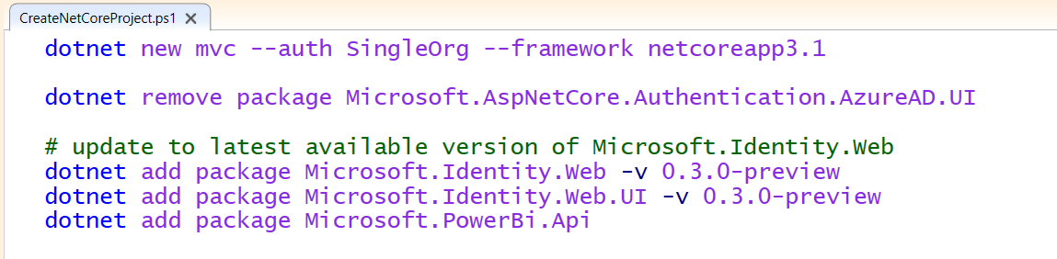
.NET 5 CLI
The .NET 5 command-line interface (CLI)
Cross-platform toolchain for creating, debugging and publishing applications
Create new applications using dotnet new command
Add NuGet packages using dotnet add package command

Slide 13
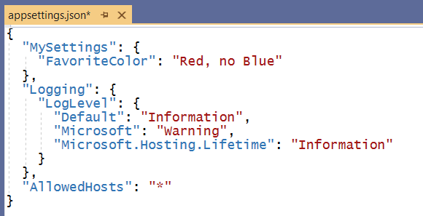
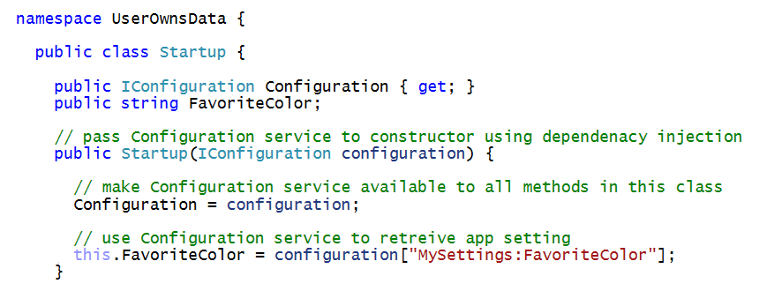
Understanding Dependency Injection is Essential
Services are registered on application start up
Services injected into classes using parameterized constructors
Dependency injection

Slide 14
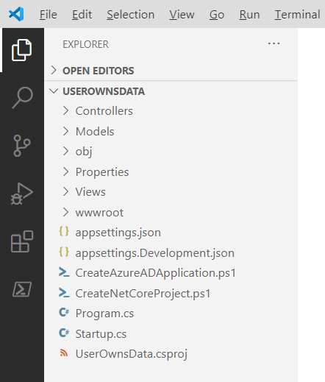
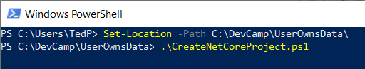
Exercise 1 Create a New .NET 5 MVC Web Application Project

Slide 15
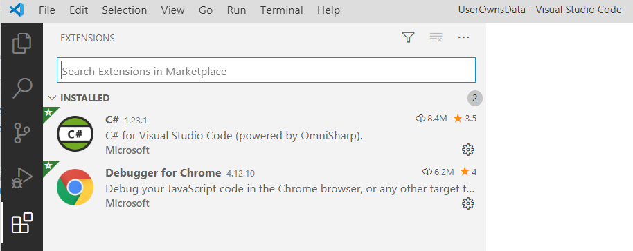
C# Extension for Visual Studio Code

Slide 16
Agenda
Tutorial Introduction
Developing with .NET 5
Introducing Microsoft.Identity.Web
Calling the Power BI Service API
Programming the Power BI JavaScript API
Adding TypeScript Support to a. NET Core Project
Programming with Multi-Resource Embed Tokens

Slide 17
Introducing Microsoft.Identity.Web
What is Microsoft.Identity.Web
Set of components and classes to assist developers
Used to perform authentication in Web applications and Web APIs
Used to acquire access tokens
Used to implement token caching
When to use Microsoft.Identity.Web
In Web application and Web APIs built on .NET 5 3.1 and .NET 5
Microsoft.Identity.Web is currently in preview
Scheduled for release with .NET 5 in November 2020
More info at https://github.com/AzureAD/microsoft-identity-web/wiki

Slide 18
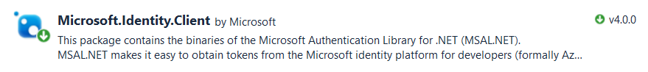
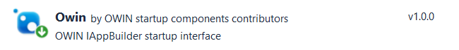
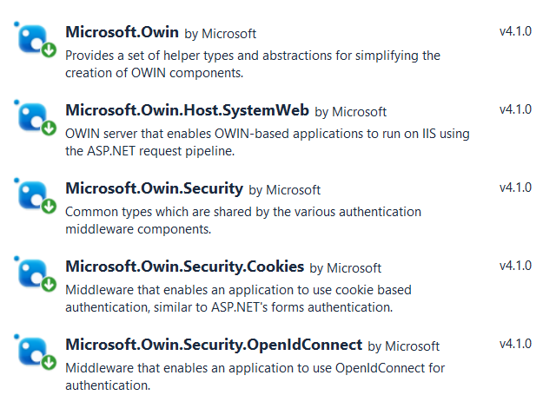
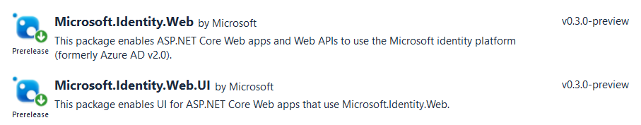
Microsoft Authentication Libraries
What did we do before Microsoft.Identity.Web?
Use Microsoft.Identity.Client (MSAL) to acquire and cache access tokens
Use OWIN Middleware components to implement OpenID connect
Microsoft.Identity.Web supports OpenID Connect and token acquisition

Slide 19
Exercise 2 Implement User Login using Microsoft.Identity.Web
Create a Confidential Client Application in Azure AD
Implement OpenID Connect using Microsoft.Identity.Web
Test Secured Routes in an ASP.NET 5 Web Application

Slide 20
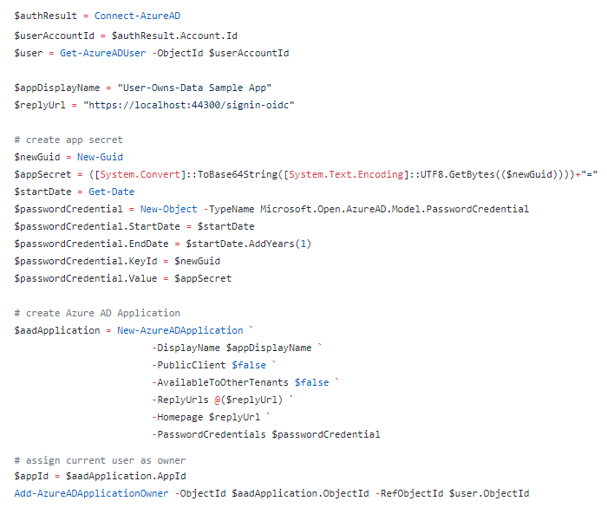
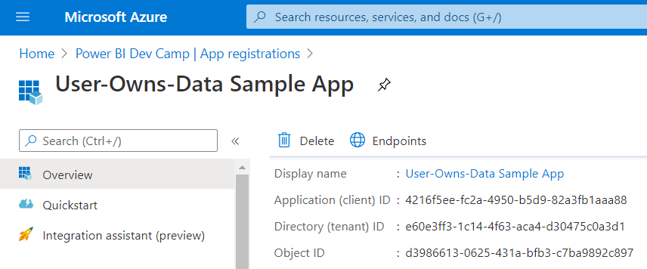
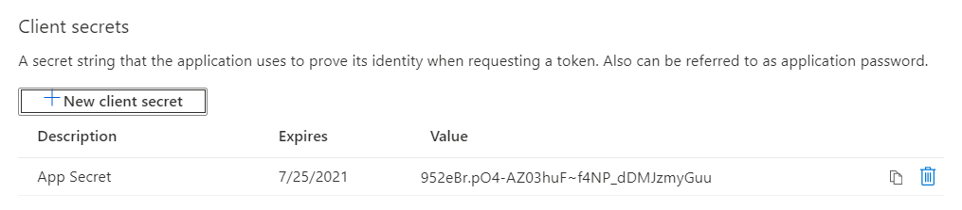
Creating Azure AD Application with PowerShell

Slide 21
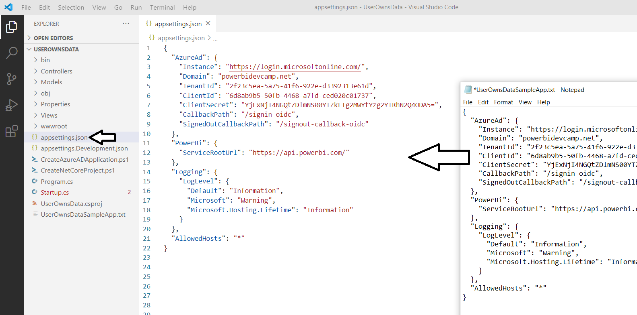
Azure AD Configuration in appsettings.json

Slide 22
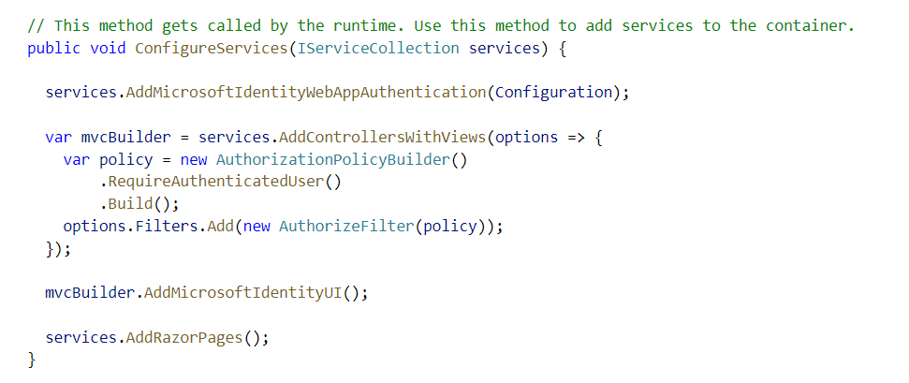
Enabling Authentication with Microsoft.Identity.Web

Slide 23
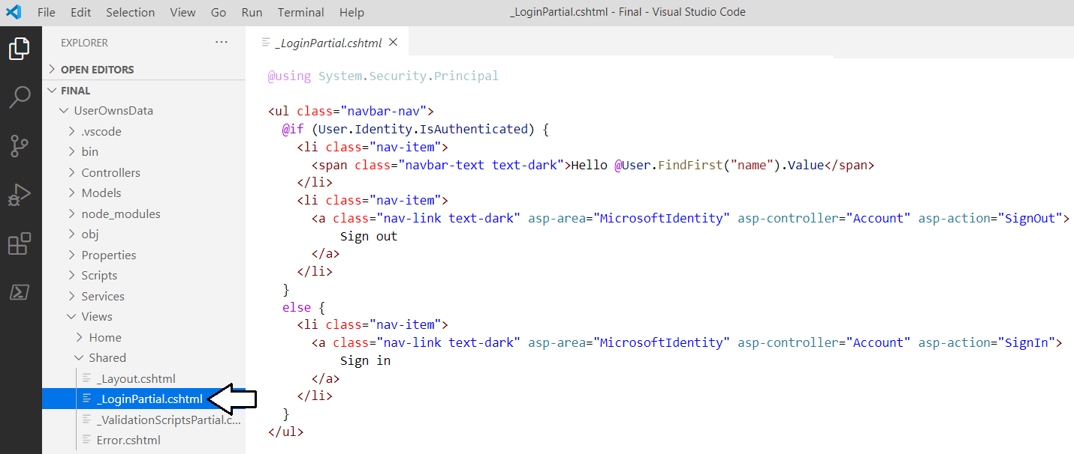
Adding Sign in / Sign Out Links

Slide 24
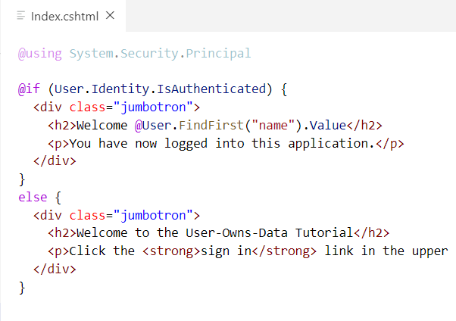
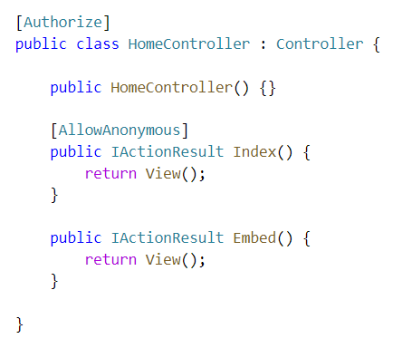
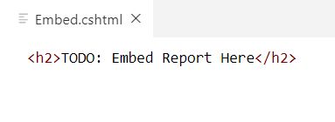
ASP.NET Supports Route Authorization
Routes with [AllowAnonymous] accessible to anonymous user
Routes secured with [Authorize] only accessible to authenticated users
Navigating to secured route automatically prompts for sign in
Index.cshtml
Embed.cshtml

Slide 25
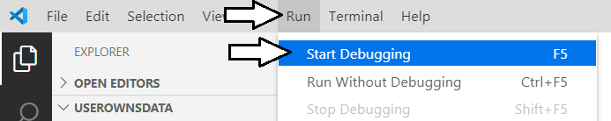
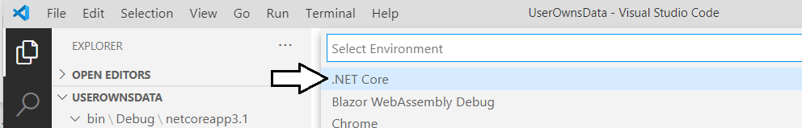
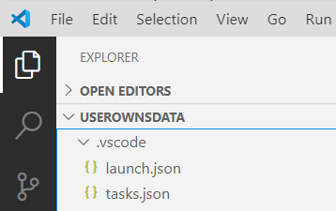
Starting a .NET 5 Debugging Session

Slide 26
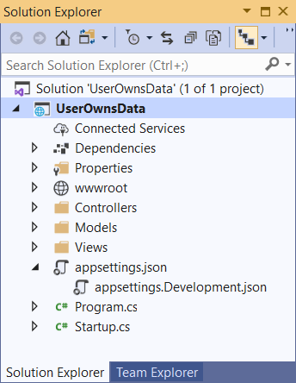
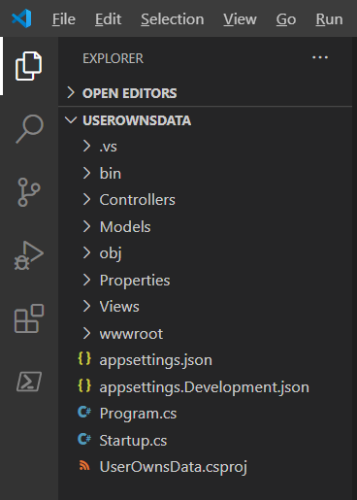
Visual Studio 2019 versus Visual Studio Code
Should you use Visual Studio 2019 versus Visual Studio Code?
Yes, either one can be used to develop for .NET 5 3.1 and .NET 5

Slide 27
Agenda
Tutorial Introduction
Developing with .NET 5
Introducing Microsoft.Identity.Web
Calling the Power BI Service API
Programming the Power BI JavaScript API
Adding TypeScript Support to a.NET 5 Project
Programming with Multi-Resource Embed Tokens

Slide 28
What Is the Power BI Service API?
What is the Power BI Service API?
API built on OAuth2, OpenID Connect, REST and ODATA
API secured by Azure Active Directory (AAD)
API to program with workspaces, datasets, reports & dashboards
API also often called “Power BI REST API”
What can you do with the Power BI Service API?
Publish PBIX project files
Update connection details and datasource credentials
Create workspaces and clone content across workspaces
Embed Power BI reports and dashboards tiles in web pages
Create streaming datasets in order to build real-time dashboards

Slide 29
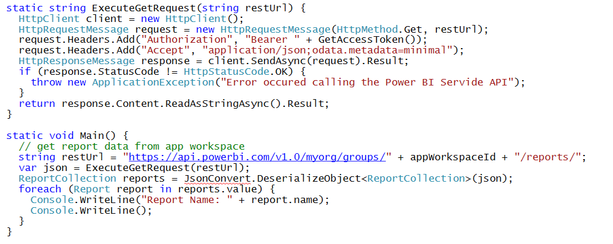
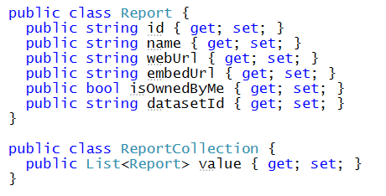
Calling the Power BI Service API Direct REST calls without using the Power BI .NET SDK
Your C# Code
Power BI
Service API
Executing HTTP Requests
Capturing HTTP Responses
Serializing/Deserializing JSON

Slide 30
Power BI .NET SDK
Developing without the Power BI .NET SDK
Developing with the Power BI .NET SDK
Your C# Code
Power BI
Service API
Executing HTTP Requests
Capturing HTTP Responses
Serializing/Deserializing JSON
Your C# Code
Power BI
Service API
Power BI .NET SDK
Executing HTTP Requests
Capturing HTTP Responses
Serializing/Deserializing JSON

Slide 31
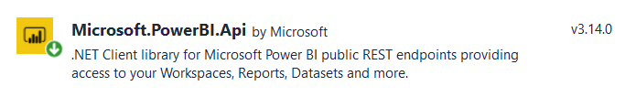
Migrating to v3 of the Power BI .NET SDK
You must move to SDK v3 to take advantage of latest API features
Automated server-side generation of PDF file from Power BI report
Generation of multi-resource embed tokens
Beware of breaking changes when moving from v2.x to 3.x
Namespace Microsoft.PowerBI.Api.v2 renamed to Microsoft.PowerBI.Api
Namespace Microsoft.PowerBI.Api.Models.v2 renamed to Microsoft.PowerBI.Api.Models
Parameters for Power BI resource IDs now based on GUIDs instead of strings

Slide 32
Exercise 3 Call the Power BI Service API
Add a new class named PowerBiServiceApi
Add support to acquire access tokens using Microsoft.Identity.Web
Call Power BI Service API to get embedding data for a report
Pass the embedding data for a report to the browser

Slide 33
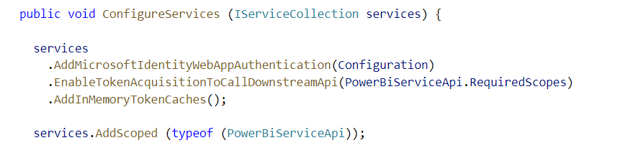
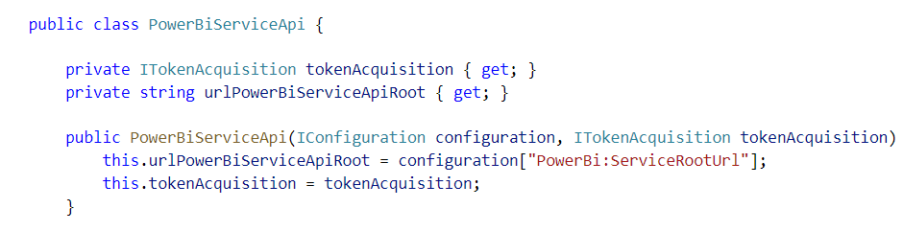
Adding Support for Token Acquisition
Modify ConfigureService in Startup.cs
Add a new C# Class named PowerBiServiceAPi
Dependency injection

Slide 34
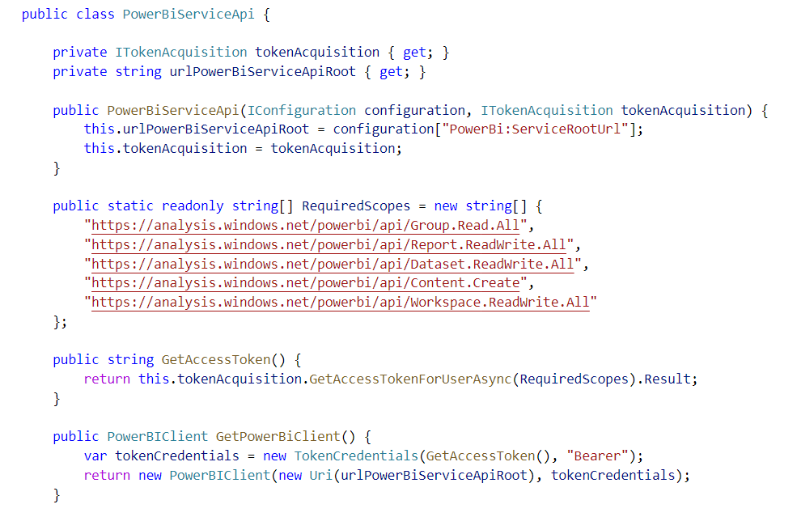
Adding Support for Acquiring Access Tokens

Slide 35
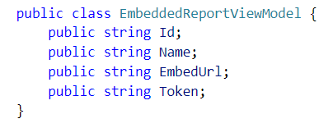
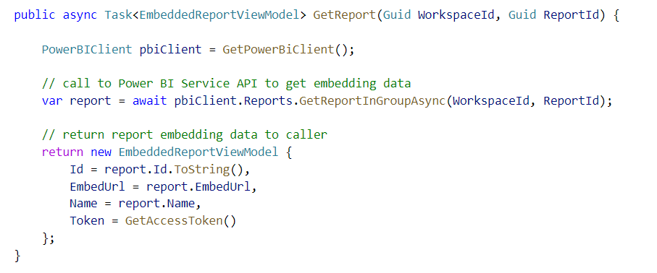
Call GetReportInGroupAsync to Get Embedding Data

Slide 36
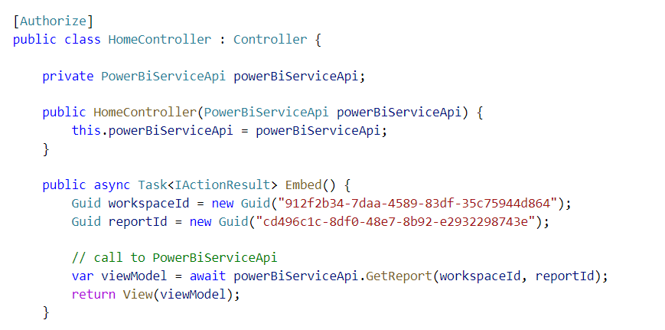
Accessing PowerBiServiceApi from a Controller
Dependency injection
MSAL Token Acquisition Service
PowerBiServiceAPI
HomeController
Dependency Injection
Dependency Injection

Slide 37
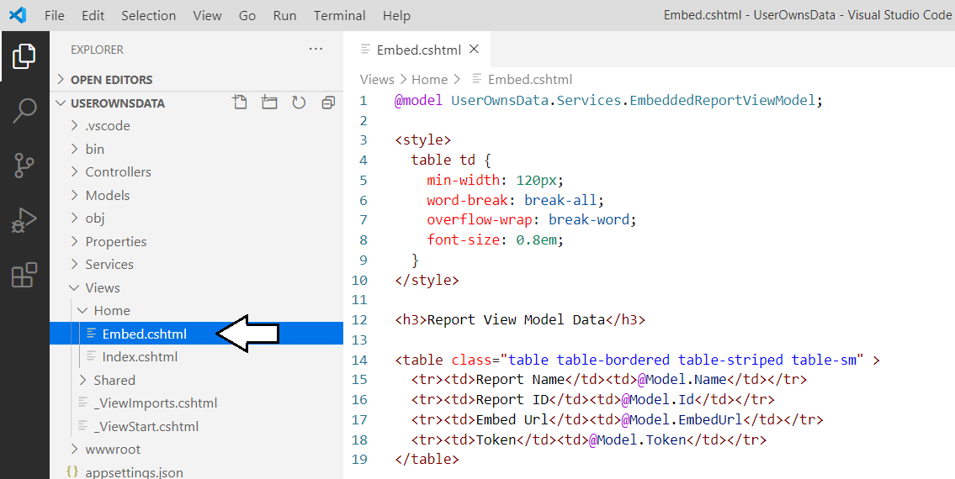
Displaying Data from the View Model

Slide 38
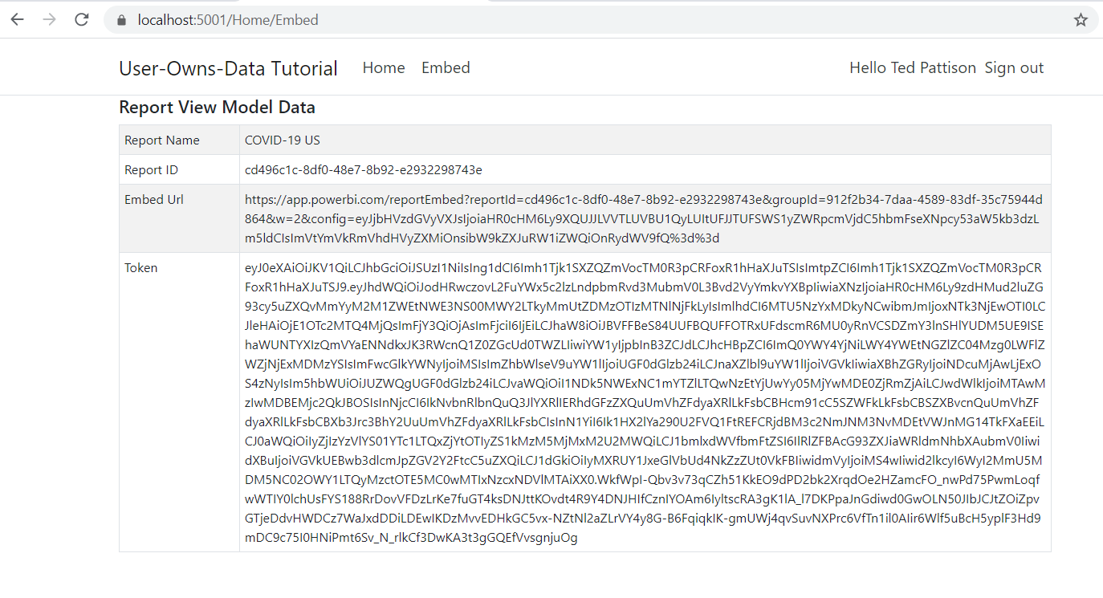
Exercise 3 Finale

Slide 39
Agenda
Tutorial Introduction
Developing with .NET 5
Introducing Microsoft.Identity.Web
Calling the Power BI Service API
Programming the Power BI JavaScript API
Adding TypeScript Support to a.NET 5 Project
Programming with Multi-Resource Embed Tokens

Slide 40
Exercise 4 Embedding a Report using powerbi.js
Add a script link to powerbi.js
Create view model to pass embedding data to browser
Write JavaScript code to embed a report

Slide 41
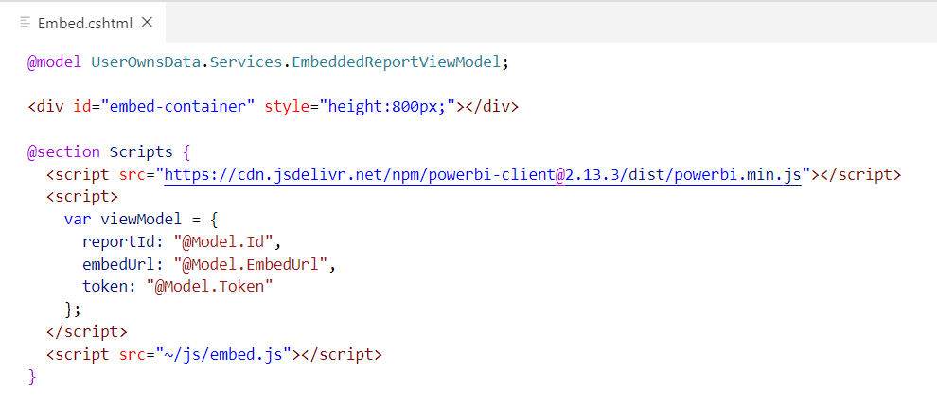
Creating a Simple View To Embed a Report
First script link loads Power BI JavaScript API
Second script link adds view model to web page with report embedding data
Third script link loads a custom Javascript file named embed.js that you will write

Slide 42
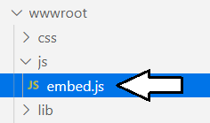
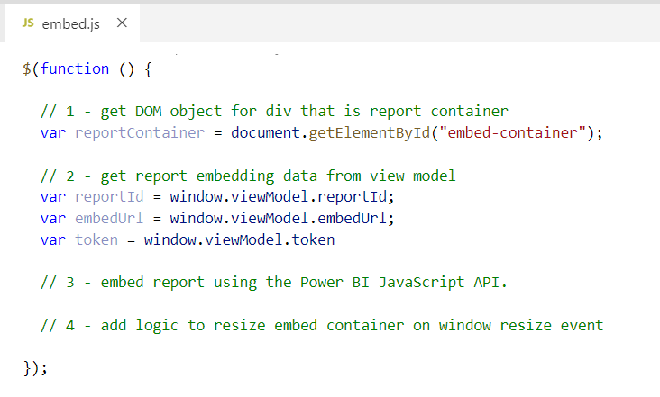
Retrieving Data from the Report View Model

Slide 43
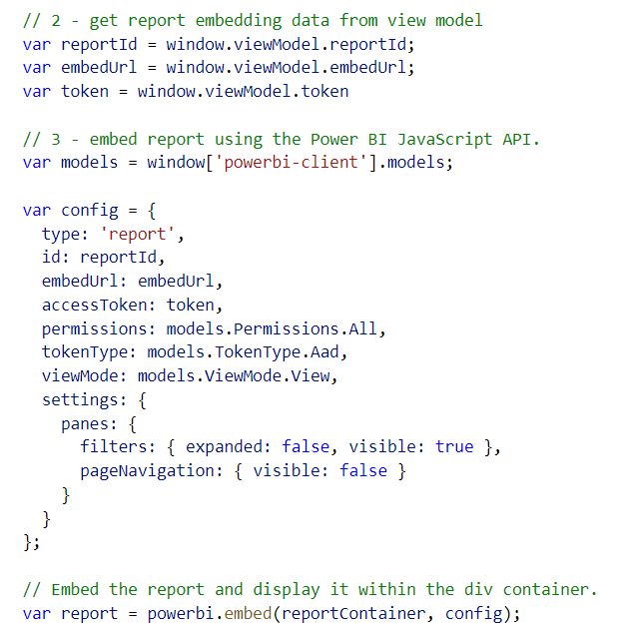
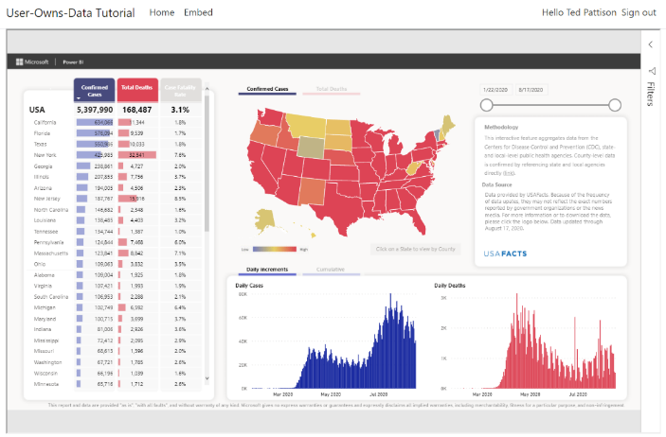
Embedding a Report using powerbi.js

Slide 44
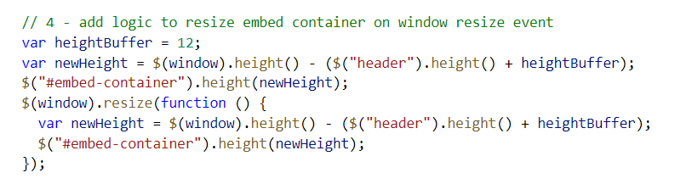
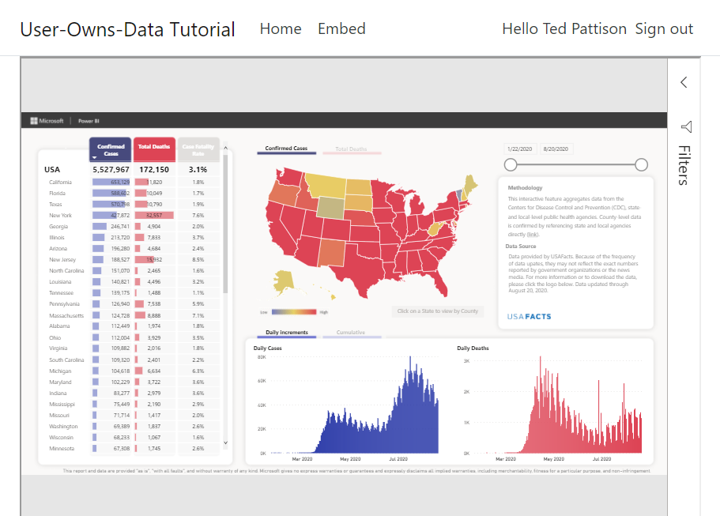
Dynamically Resizing the Embed Container

Slide 45
Agenda
Tutorial Introduction
Developing with .NET 5
Introducing Microsoft.Identity.Web
Calling the Power BI Service API
Programming the Power BI JavaScript API
Adding TypeScript Support to a.NET 5 Project
Programming with Multi-Resource Embed Tokens

Slide 46
Exercise 5 Adding TypeScript/Webpack Support to a .NET 5 Project
Copy package.json file to UserOwnsData project root folder
Execute npm install to install Node.js packages
Copy tsconfig.json and webpack.config.js to root folder
Add new TypeScript file named embed.ts
Execute npm run build to compile embed.ts to embed.js
Update UserOwnsData.csproj with npm run build command

Slide 47
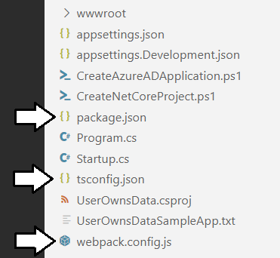
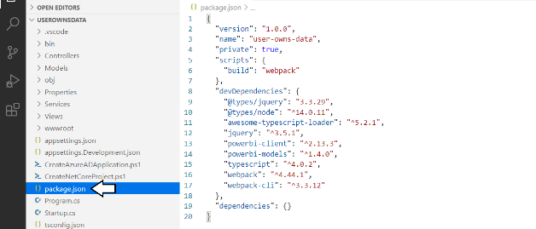
Adding Node.js Support for TypeScript Compilation

Slide 48


Running npm install

Slide 49

Understanding Webpack and Dynamic Module Loading
embed.ts
webpack
embed.js
jquery.js
Typescript Compiler
Powerbi.js

Slide 50


Running npm build

Slide 51

Updating UserOwnsData.csproj

Slide 52


Running dotnet build

Slide 53

Programming the PBI JS API using TypeScript

Slide 54


Exercise 6 Creating a View Model for App Workspaces

Slide 55

Creating the User Experience

Slide 56
Camper Competition
Competition Rules
Build a .NET 5 web application that extends User-Owns-Data tutorial
You must use Microsoft.Identity.Web for authentication
You must use TypeScript instead of JavaScript for client-side programming
Create a 3-5 minute video where you demo and describe your application

Slide 57
Agenda
Tutorial Introduction
Developing with .NET 5
Introducing Microsoft.Identity.Web
Calling the Power BI Service API
Programming the Power BI JavaScript API
Adding TypeScript Support to a.NET 5 Project
Programming with Multi-Resource Embed Tokens

Slide 58

Programming with Multi-Resource Embed Tokens
Used in App-Owns-Data embedding

Slide 59
Call to Action
Complete the Developer for Power BI with .NET 5 tutorials
Fill out the tutorial survey form
Enter the camper competition
Come back next month for our Power BI PowerShell sessions

Slide 60
Summary
Tutorial Introduction
Developing with .NET 5
Introducing Microsoft.Identity.Web
Calling the Power BI Service API
Programming the Power BI JavaScript API
Adding TypeScript Support to a.NET 5 Project
Programming with Multi-Resource Embed Tokens

Slide 61
Questions

